Slide 1
Entity Relationship Diagram
© 2007 by Prentice Hall
Management Information Systems, 10/e Raymond McLeod and George Schell

Slide 2
ERD (Entity Relationship Diagram)
is modeling tool used to depict graphically a database design before it is actually implemented.
It has three basic components, namely, an Entity, Relationship and an Attribute.
© 2007 by Prentice Hall
Management Information Systems, 10/e Raymond McLeod and George Schell

Slide 3
Entity
is a real-world object distinguishable or unique from other objects.
An entity can be a concrete or physical object like employee, student, faculty, customer etc. Or it could also be conceptual or abstract like transaction, order, course, subjects etc.
It can be thought of as a noun like student, employee etc.
It is normally represented by a rectangle shape.
© 2007 by Prentice Hall
Management Information Systems, 10/e Raymond McLeod and George Schell

Slide 4
Relationship
is a way of relating one entity to another. Entities can therefore participate in a relationship.
it is commonly thought as a verb connecting the entities or nouns.
It is normally represented by a diamond shape.
© 2007 by Prentice Hall
Management Information Systems, 10/e Raymond McLeod and George Schell

Slide 5
Example of Entities with Relationship
lives
Person
Location
enrolls
Student
Subject(s)
teaches
Faculty
Subject(s)
© 2007 by Prentice Hall
Management Information Systems, 10/e Raymond McLeod and George Schell

Slide 6
Types of Relationship
One-to-One
One-to-Many
Many-to-Many
© 2007 by Prentice Hall
Management Information Systems, 10/e Raymond McLeod and George Schell

Slide 7
Types of Relationship
has
Student
1
1
ID
One-to-One
has
Division
1
M
Program
One-to-Many
enrolls
Student
M
M
Subject
Many-to-Many
© 2007 by Prentice Hall
Management Information Systems, 10/e Raymond McLeod and George Schell

Slide 8
Types of Relationship (Crow Notation)
has
Student
ID
One-to-One
has
Division
Program
One-to-Many
enrolls
Student
Subject
Many-to-Many
© 2007 by Prentice Hall
Management Information Systems, 10/e Raymond McLeod and George Schell

Slide 9
Attribute
Refers to the characteristic or basic fact or field of an Entity or Relationship.
For example a Student entity could have the following attributes ID Number, Last Name, First Name, Address, Birth Date etc.
A relationship could also have an attribute for example an Entity name Student enrolls (relationship) to a Course/Program. Now, when you enroll you enroll on a certain date so you will have an attribute of Enrollment Date under Enroll relationship.
It is normally represented by a circle.
© 2007 by Prentice Hall
Management Information Systems, 10/e Raymond McLeod and George Schell

Slide 10
Example of Attributes
Lastname
Firstname
ID No.
Gender
Student
Address
Birth date
Email
Note : A Primary Key is Underlined, in this case the ID No.
© 2007 by Prentice Hall
Management Information Systems, 10/e Raymond McLeod and George Schell

Slide 11
Example of Attributes
Name
Chairperson
Lastname
Firstname
Program ID
Enrollment
Date
ID No.
Gender
Program
enrolls
Student
Address
ID No.
Birth date
has
Email
Faculty
manager
Fname
© 2007 by Prentice Hall
Management Information Systems, 10/e Raymond McLeod and George Schell

Slide 12
Example of Attributes
Name
Chairperson
Lastname
Firstname
Program ID
Enrollment
Date
ID No.
Gender
Program
enrolls
Student
Address
ID No.
Birth date
has
Email
Faculty
Manager
Faculty
Name
© 2007 by Prentice Hall
Management Information Systems, 10/e Raymond McLeod and George Schell

Slide 13
Recursive ERD
manages
Employee
© 2007 by Prentice Hall
Management Information Systems, 10/e Raymond McLeod and George Schell

Slide 14
ERD with Ternary Relationship
Supplier
supplies
Product
Customer
© 2007 by Prentice Hall
Management Information Systems, 10/e Raymond McLeod and George Schell

Slide 15
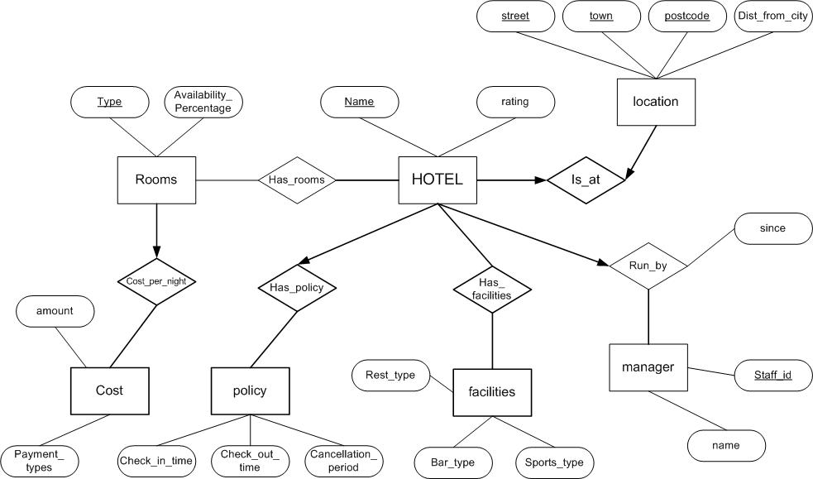
ERD (More Examples)
© 2007 by Prentice Hall
Management Information Systems, 10/e Raymond McLeod and George Schell

Slide 16
ERD (More Examples)
Manages
Code
Name
Name
Employee
Is_a_Member
Department
Dept ID
Age
Salary
Participates
Start Date
has
Start Date
City
Name
Project
Branch
Budget
Address
Release Date
© 2007 by Prentice Hall
Management Information Systems, 10/e Raymond McLeod and George Schell

Slide 17
See also how to draw an use case diagram:
https://www.youtube.com/watch?v=KDCiwa6pX9Y
© 2007 by Prentice Hall
Management Information Systems, 10/e Raymond McLeod and George Schell

